Slide 1
FILIPA
Realtime Hand Gesture Control System
Kunal, Siddharth, Yogesh
Intern-Technology

Slide 2
Problem Statement
Solution

Slide 3
Problem Statement
Filipa was initially developed using Microsoft Kinect and was hardware dependent.
Requirement of Kinect restricted it’s mobility and presence on other devices

Slide 4


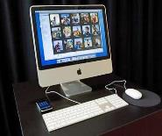

Proposed Solution
Using power of computer vision and Machine Learning, hardware dependency was removed making it all software dependent.
Using webcam capture Video
Using Object detection and
Computer Vision detect hand
Detect hand movement and
Send instruction to computer
Read the instructions sent and
Act accordingly

Slide 5
Any Questions ?

Slide 6
CIO Calls
Realtime speech to text conversion and topic modelling
Kunal, Siddharth, Yogesh
Intern-Technology

Slide 7
Problem Statement
Solution

Slide 8


Problem Statement
Every Monday CIO’s of fidelity deliver speeches regarding market trends and their impact.
Employees who miss these calls are not able to know about them as no record keeping is done

Slide 9





Proposed Solution
Record every weekly calls
Use Speech to Text model to get their transcripts.
Find important words and context.
Tag speeches with their important words
Search recording with keyword.
Weekly Calls
Record Calls
Process With Speech to text model
Get transcripts tagged with important words

Slide 10





Work Flow
Jasper Model
Language Model
Audio file
Jasper Transcript
Refined Transcript
TF-IDF
Trained TF-IDF
Important
Words
Financial Word Corpus

Slide 11
Any Questions ?

Slide 12
Digital Crowd Sourcing Platform For Machine Learning
Kunal, Siddharth, Yogesh
Intern-Technology

Slide 13
Problem Statement
Proposed Solution
Purpose and Use Cases

Slide 14
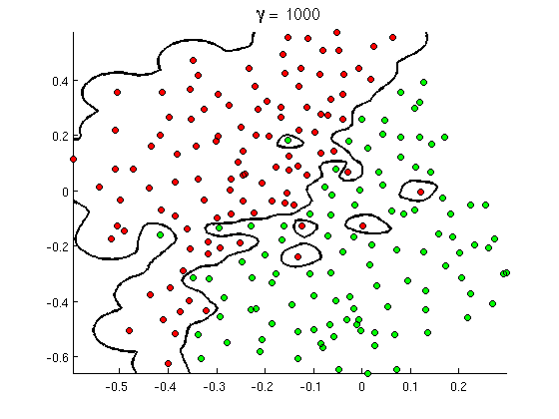
Problem Statement
With so much of buzz of AI and ML within the industry, everyone is into Machine Learning. But they don’t get a platform within the company to prove their mettle and outshine.
Where can I compete with my skills ?

Slide 15
Proposed Solution
FILearn
A crowdsourcing platform is created for holding machine learning based competitions which will be open for all fidelity employees for participation. Winners of a competition will be awarded incentives as mentioned in that competition details.
FILearn
Create
Collaborate
Compete

Slide 16
Purpose and Use Cases
Any Machine Learning or Artificial Intelligence based problem faced by any department in Fidelity International can be solved using this platform by conducting competitions. Work is outsourced to participants. Models made by participants would be saved to gather opinions and top submissions would be used in the final solution of the problem.
Code from archived competitions would be open sourced. This would create a large repository of open source Machine Learning models which can be revisited for educational purposes and as references for similar problems in future.
This platform can also be used to facilitate Internal Job Postings for data scientists.
This platform will help in creating opportunities and raising awareness in the field of machine learning.

Slide 17
Any Questions ?

